Slide 1


Thriving at Suckley School

Slide 2

What is the Thrive Approach?
Thrive helps adults prepare children and young people for life’s emotional ups and downs
Thrive is rigorous, targeted and measured.
Thrive tells you how to be and
what to do with children’s differing
and sometimes challenging
behaviours to help them engage
with life and learning.

Slide 3
WHY use thrive?
Thrive helps address the problems caused by interrupted emotional development in children and young people.
It underpins many troubling behaviours and leads to under-achievement
It lies at the heart of many health and mental health problems and gives rise to adverse social issues and can be costly both monetary and socially to communities
It isolates children from life and their learning

Slide 4
What are the benefits?
Thrive will helps you develop targeted interventions for groups and individual children
Thrive tells you what to do and how to do it
Thrive is easy to implement the non-therapeutic interventions
Thrive allows you to measure and monitor progress

Slide 5
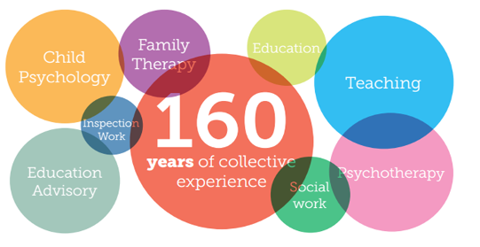
Where did thrive come from?
The Approach was devised in 1996 by four founder directors to front the challenge for children with unmet social and emotional needs.

Slide 6
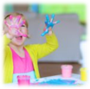
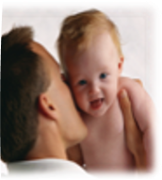

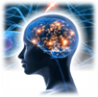
WHAT IS THRIVE BASED ON?
Established research in neuroscience
Attachment research
Child development theory
Reasearch into the role of creativty and play

Slide 7
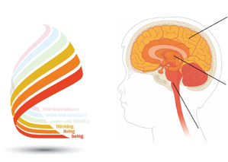
NEUROSCIENCE THE TRIUNE BRAIN
Three interlocking systems
Cortex
The cognitive- thinking brain
Limbic system
The emotional- mammalian brain
Brain stem
The instinctual- reptilian brain

Slide 8
THE INSTINCTUAL BRAIN
Importantly the structures in this part of the brain are responsible for coordinating the fight/ flight or freeze response.
Pre-birth to 6 months this part of the brain develops rapidly. A baby can only communicate and show distress through crying, smiling and eye contact. So holding and soothing, having eye contact, the world of the face, smiling, reassuring and repetition [singing, rhymes, talking] are critical for healthy development of this part of the brain.
Also known as the survival or reptilian brain. It is made up of the brain stem and cerebellum. Which are located at the base of the brain and connect directly to the spinal cord. The instinctual brain is responsible for coordinating and regulating the essential bodily functions needed for basic survival and maintain consciousness, including the regulation of breathing, temperature, movement and balance, hunger, digestions, circulation, heart rate and sleep cycles.

Slide 9
THE MAMMALIAN BRAIN
Also known as the emotional brain, refers to the limbic system. This comprises a complex set of structures, which cluster around the top of the brain stem. The limbic system is common to all mammals. Often described as the seat of emotions, the limbic system is largely responsible for monitoring our external environment for threats and opportunities, it is essential for alerting us to danger and enables us to recognise and experience pleasure and reward.
Exploration and play are important to develop this part of the brain.

Slide 10
The Cognitive brain
The cognitive brain, also known as the rational brain, refers to the cortex or neo cortex. The cortex comprises of two halves, the right and the left hemispheres. Each of the two hemispheres is divided into four lobes.
The frontal lobes are largely responsible for our cognitive capabilities, the ability to think, predict, plan, reason and control our impulses; understanding cause and effect, language , creativity and imagination, reflection and self awareness.
When operating effectively. The cognitive brain enables us to inhibit the responses of our emotions and instinctual brain in order to give us choice in how we respond to our environment.

Slide 11
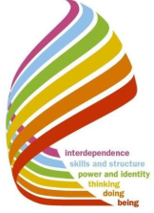
The Developmental stages
Each stage comes 'online' sequentially and remains in play throughout life

Slide 12
EARLY DEVELOPMENT OF NEURAL PATHWAYS
Neurons are the core component of the brain and nervous system. A neurons function is a bit like electrical wires carrying information along their length, via electrical impulses.
Synapses are minute gap between a neuron and another cell across which information is transmitted using chemical signals.
Myelination- Over time neural networks that are used particular frequently become myelinated and a pathway is formed.
Pruning- Synaptic processes that are underused fall away.
•Pruning and Myelination give the brain its neuroplacity.
•Birth- neurons unconnected, like the dangling wires of a Computer.
•By18 months some neuron formed
•18m-3years - A child connections have become more complex and the pruning has begun.
•Adulthood- Overall number of neuron and connections are reduced and pathways have become myelinated.
•Repetitions – It takes about 500 or more repetitions to learn something new and form habits.
In the context of thrive the children we work with will need repeated relational experiences. To develop positive neural pathways.

Slide 13
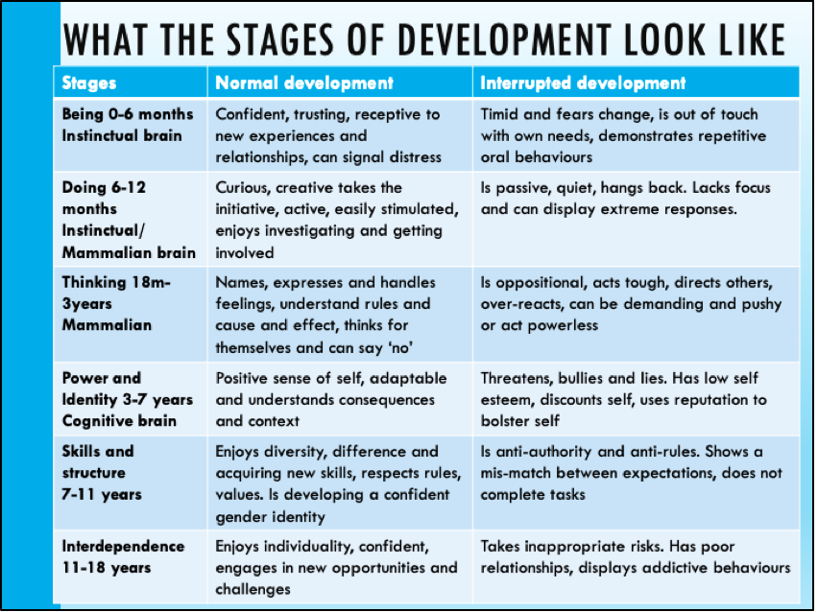
What the stages of development look like

Slide 14

Holes in our development

Slide 15
Interrupted development
The Neural pathways are formed in response to internal and external environment.
It is the nature of what we experience particularly our emotional experiences with care givers within the first few years.
The amount and quality of care will determine the connections that form between the neuron and eventual pattern of our neural networks.
Our early experiences are CRITICAL in shaping the course of our social and emotional development. Whether or not we can develop the capacity to love, empathise and form healthy relationships. Whether we are able to respond effectively to stress.

Slide 16
Triggers than can affect emotional development
Loss/Bereavement
Separation
Medical needs/treatments
Trauma
Gaps in sensory and relational experiences

Slide 17
How we can help...Suckley School PACE Ethos
Dan Hughes identified key features that can help a child grow a healthy sense of themselves. These features help with emotional learning.
Playful- Attuning- being alert and understanding
Accepting- It is alright to feel the way they are feeling
Curious- Asking how a child is feeling
Empathy- Be empathetic, try to understand.

Slide 18
Vrf'S: In the Thrive programme when everything becomes too overwhelming for children in school, we as the adults need to adopt our VRFs https://www.youtube.com/watch?v=t685WM5R6aM
Vital Relational Functions
Attunement- Showing you can catch how they feel through facial expressions, body language, gesture and noises, mmm, oh, aah
Validation- Validate their perspective- I can see you are upset, angry, scared.
Containment- Make their deep distress, raging anger, or painful sorrow a survivable experience. Be near, hold their hand, put your hand on their shoulder.
Soothe/ Calm- Teach them to calm themselves down, this will take lots of practice. Breathe with them.
Regulate- Helping the child regulate their emotions by naming what they are feeling ‘naming is taming.’

Slide 19
Rigorous assessment using Thrive online
All Thrive practice is underpinned by Thrive-Online.
A simple-to-use program that provides:
1.Whole group profiling
2.Individual profiling/assessment
3.Tailored action-planning
4.Progress-monitoring and reviewing
5.Measured outcomes

Slide 20
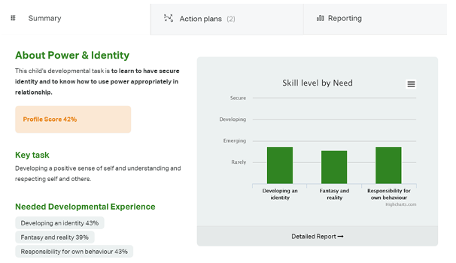
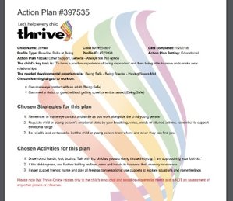
Individual and group summaries and action plans

Slide 21
Reviewing and monitoring
The impact of the strategies should be reviewed every
4 to 6 weeks
Progress can be monitored and tracked by re-profiling a group or
an individual
Reports can be generated to share with other staff, parents or to send to other professionals or agencies.

Slide 22
What THRIVE SESSIONS MIGHT LOOK LIKE...
Exploratory play
Story sharing
Physical play- link to real PE
Baking/snack sharing
Meditation and yoga
Breathwork
Mirror games
Blowing bubbles
Singing and musical instruments
Messy play with gloop/slime
Nature play- big forest school link
Hand and footprints

Slide 23
Whole Class Activities
-Meditation bowl
-Breathing exercises (ball, flower, box, teddy bear, nostril…)
-Exploring feelings through metaphor (colours, animals, foods, drinks, toys…)
-Shining the light on behaviours and problem solving
-Meditation and guided visualisations
-Mindfulness colouring
-Yoga sessions

Slide 24
TRAUMA INFORMED SCHOOLS
Thrive is trauma-sensitive approach to meeting the emotional and social needs of children. The Thrive approach provides us with the rigour in our approach to this by providing screening and assessment tools and giving us the tools, activities and action plans to inform us in the best way to support our children.

Slide 25
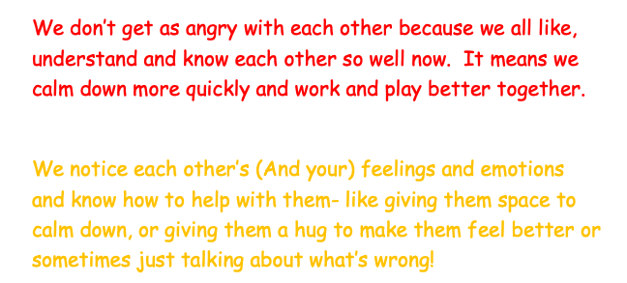
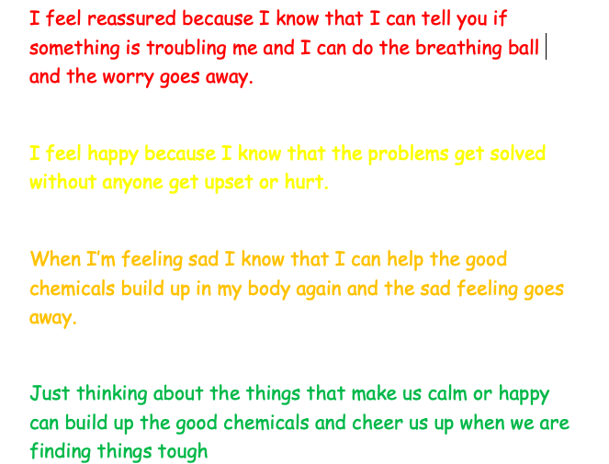
What the children have to say...

