Slide 1


Year One Phonics Screening Check 2024.
Information for parents
^{8th May 2024}

Slide 2
What is the Phonics Screening check?
This is a Department of Education (DfE) statutory test.
During the week beginning 10th June 2024, those children who will be six years old by the end of the school year will take the screening check.
Most of these children will be in Year 1.
Any children who will be seven years old by the end of the school year (Year 2) and who missed the screening check in 2023, or who did not meet the required standard must also take the check.

Slide 3
Why is there a phonics screening check?
The check is designed to assess children’s phonics skills and to help identify those pupils who need extra support in decoding and reading words using phonics.
The results of the screening check are submitted to the local authority.

Slide 4
Do all year 1 pupils need to complete the phonics screening check?
Most children complete the check.
On rare occasions, the headteacher can disapply a child if they have additional needs that would make participation impossible e.g., if a child communicates using British Sign Language (BSL) or is selectively mute.

Slide 5
What is the expected standard for the year 1 phonics screening check in 2023?
The DfE will publish the threshold mark in June 2024.
In 2023 the threshold mark was 32 out of 40.
Those children who do not achieve the threshold mark in Year 1 may take the check again in June 2025. School will continue to support these pupils to help them to achieve the required standard.

Slide 6
How are results of the phonics screening check reported to parents?
You will receive your child’s score by the end of the summer term, in the written summer report document.
This will include whether or not the child has met the expected standard and the numerical score.

Slide 7
How is the phonics screening check administered?
There are 40 words for the children to read. The check is designed to test the child’s knowledge of phonics and their ability to blend to decode each word. Some are pseudo words and are accompanied by an image of an alien.
The check is administered by a member of staff who is trained in phonics and is known to the child. We moderate by having an additional known adult in the room to monitor.
The child sits one-to-one with the member of staff throughout the check.

Slide 8
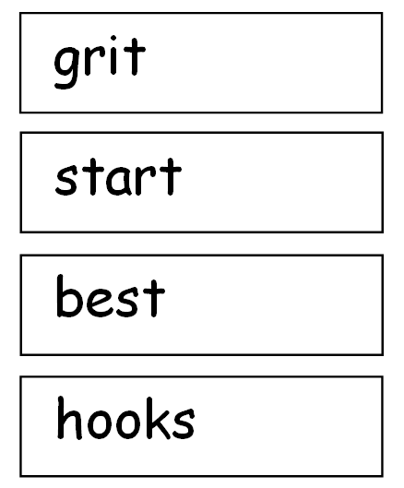
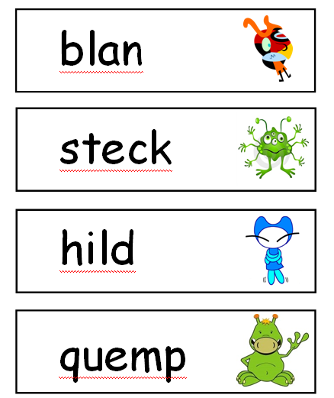

Slide 9
What can you do to help?
Read – daily reading helps children to put into practice the sounds they are being taught.
Use flash cards/ sound mats to practice sounds.
Use word lists to practise decoding words that have specific sounds in.

Slide 10
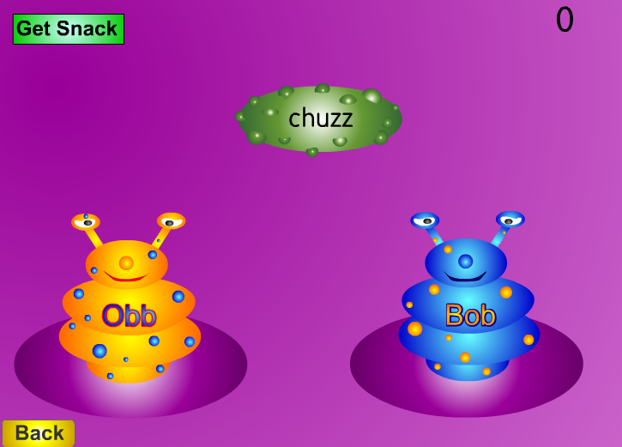
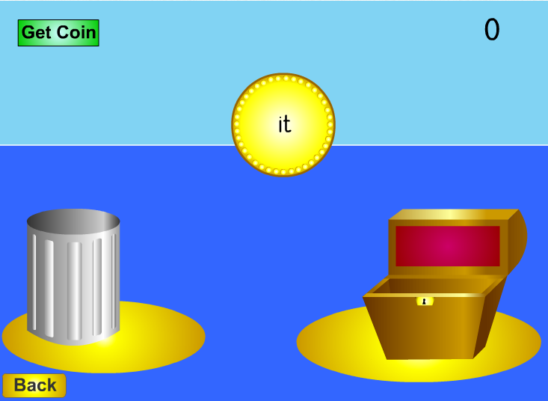
Resources
http://www.phonicsplay.co.uk

